Slide 1
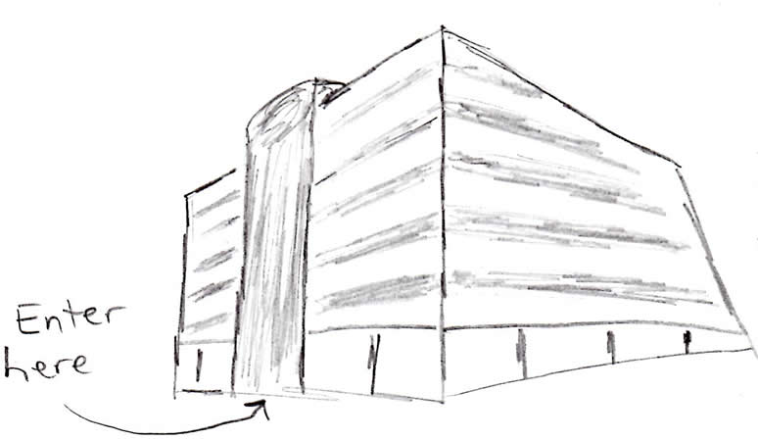
Intro Animation and Office Walkthrough (exterior)
Notes:
Animator:
Three-dimensional flyover outside the corporate office building of the learners
Enter building through the front doors

Slide 2
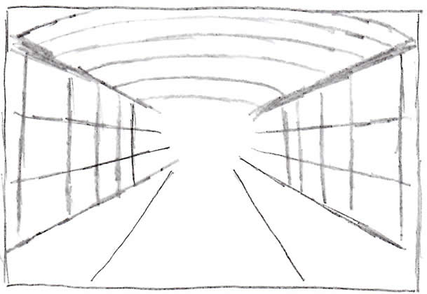
Intro Animation and Office Walkthrough (interior)
Notes:
Animator:
Travel through hallways, occasionally turning into offices then backing out, as if looking for someone
Finally turn down a larger hall with a closed door at the end of the hall
Low-volume, unintelligible voices are heard outside the door, but get a little louder as the door is approached
The door opens to show an impromptu meeting among five executives about a new training project. The executives are a mix of males and females, and are of different racial groups.

Slide 3
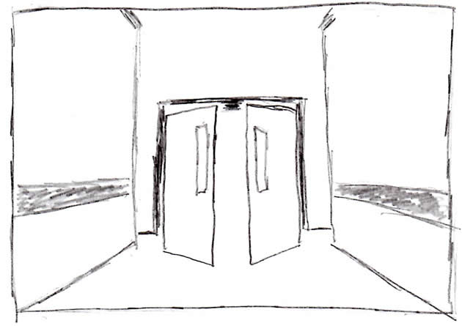
Intro Animation and Office Walkthrough (entering office)
Notes:
Animator:
The door opens to show an impromptu meeting among five executives about a new training project. The executives are a mix of males and females, and are of different racial groups.

Slide 4
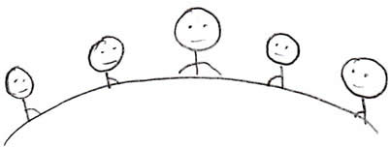
Animation of Executive Meeting
Notes:
Script:
Executive 1: Yeah, see…the problem is we have a lot of great workers. They’re very skilled… some are the best at what they do. But organization…especially with meetings…planning and organization with meetings is a big problem.
Executive 4: That’s what I’m hearing from management. They can assign someone on their team to facilitate a meeting, and when the meeting is over, very little has been accomplished, and no action items have been assigned. We need to make our meetings more productive.
Executive 3: Right, usually the problem is no planning up front…no agenda. And when there is agenda, it’s not followed. Meetings go off topic, people are taking calls on their cells or writing emails…not to mention that a lot of the meetings start late.
Executive 5: All these things are unacceptable. We have some of the best people in the business…we just need to give them a little structure. My team sent out an email last week that outlines our new direction resolving this issue…training to help our people conduct effective meetings. We’re thinking that this kind of training will provide what they need to know to conduct effective meetings. But also, the organizational skills alone will help them do their day-to-day jobs more efficiently and make things easier for them.
Executive 2: Sounds like we’re all on board. Who are gonna put on it?
Executive 1: Let’s get Lucas in here…he knows about this stuff.

Slide 5
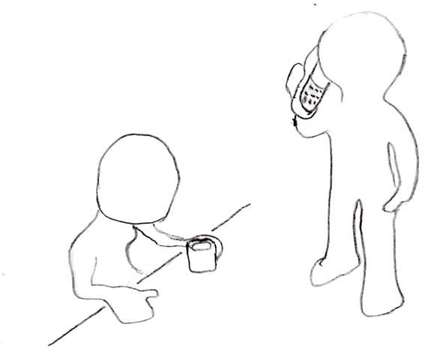
Introduction of Lucas
Notes:
Animator:
Fade to Lucas in the break room taking a coffee break.
Lucas’ cell phone buzzes, and he answers.
Script:
Lucas: I’m on my way.

Slide 6
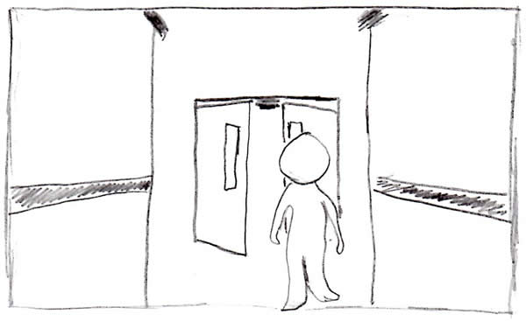
Lucas Walks to Executive Meeting
Notes:
Animator:
Lucas walks to the office; we hear his footsteps as he approaches the office and opens the door.

Slide 7
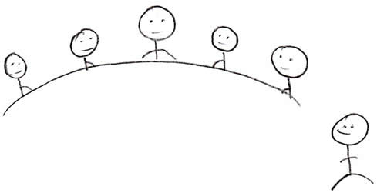
Lucas Arrives at Executive Meeting
Notes:
Animator:
Lucas enters the office.
Script:
Executive 1: You get the email on what we plan to do for training?
Lucas: Yeah.
Executive 1: We want you to develop it.
Lucas: I’ll see what I can do.

Slide 8
Learning Outcomes
After you finish this course, you should be able to:
Prepare a clear agenda for your meeting attendees
Manage the duration of your meeting
Assign action items at the end of your meeting
Notes:
Developer:
As the first paragraph is spoken, fade in and out random images of the visuals the learners will see later in the course.
After the first paragraph is finished, display the list items as they are spoken.
Script:
You’re doing an excellent job, but you’ve been asked to take this course to help you do an even better job. This course is going to help you conduct more productive meetings. As I said, you’re already doing an great job, but improving your ability to conduct effective meetings will help you work more efficiently, and may even make some parts of your job easier.
After you finish this course, you should be able to:
Prepare a clear agenda for your meeting attendees
Manage the duration of your meeting; and
Assign action items at the end of your meeting

Slide 9
Section 1: Preparing an Agenda (not storyboarded)
To prepare an effective agenda:
…
…
…
Notes:
Script:
To prepare an effective agenda…

Slide 10
Section 2: Time Management
You should be prepared…
Item 1…
Item 2…
Item 3…
Static image to represent time management
Notes:
Developer:
Display the bulleted items of the script to the left of the “clock-man” image as they are spoken.
Script:
In this section, we’ll talk about managing the duration of your meeting. It’s very important to make sure that you make it through your entire agenda within the allotted time. Several things may happen during your meeting that may cause delays. And if you have delays, you may not have enough time to address everything you’d like, or your meeting may to run over time.
You should be prepared to handle any issues that could potentially cause delays. Potential issues are:
Starting the meeting late
Attendees reading and responding to emails, or taking phone calls
Attendees not having required documents
Attendees discussing irrelevant topics
You can address the issues by:
Starting the meeting on time
At the start of the meeting, asking attendees not to read or respond to emails, and to turn off cell phones.
Bring extra copies of required documents
Steering the attendees back to the agenda items when the meeting goes off track
Let’s take a moment to practice dealing with some of these issues.

Slide 11
Section 2: Time Management
Instructions: Meeting Clock
Watch the clips of a meeting.
When the animation stops decide what to do to keep the meeting on track.
If you choose correctly, time will be added. If you choose incorrectly, time will be subtracted.
End the exercise with at least 20 minutes remaining on the meeting clock.
Notes:
Developer:
Display the instructions as they are spoken.
Script:
For this exercise, you must accrue 20 minutes in order have enough time to conduct an upcoming meeting. You can accrue time by answering questions correctly.
Watch the clips of a meeting. When the animation stops select the appropriate response for what you should do to keep the meeting on track. After you decide what to do, the animation will continue by showing you what would happen based on your selection. If you choose correctly time will be added to the meeting clock. If you choose incorrectly, time will be subtracted from the meeting clock. Remember, your goal is to end the exercise with at least 20 minutes on the meeting clock.

Slide 12
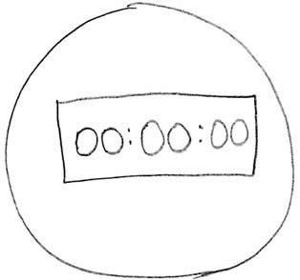
Section 2: Time Management
Activity 1: Meeting Clock
Notes:
Developer:
Play Animation 1.
The animation should stop after a meeting attendee begins to read and respond to emails.
After the animation stops, show the following question:
What should you do?
Admonish the attendee for not paying attention
Politely ask the disruptive attendee to leave
Politely ask the attendee to rejoin the discussion
After the user makes a choice, play the corresponding animation (1A, 1B, or 1C)
If the user selects:
Subtract 10 minutes from the clock
Subtract 10 minutes from the clock
Add 10 minutes to the clock

Slide 13
Section 2: Time Management
Activity 2: Meeting Clock
Notes:
Developer:
Play Animation 2.
Stop the animation after a meeting attendee explains that they do not have a copy of document that is currently being reviewed.
After the animation stops, show the following question:
What should you do?
Give the attendee one of your extra copies of the document
Admonish the attendee for not having the document
Rather than disrupt the meeting further, proceed without the attendee’s input
After the user makes a choice, play the corresponding animation (2A, 2B, or 2C)
If the user selects:
Add 10 minutes to the clock
Subtract 10 minutes from the clock
Subtract 10 minutes from the clock

Slide 14
Section 2: Time Management
Activity 3: Meeting Clock
Notes:
Developer:
Play Animation 3.
The animation should stop after a meeting attendee asks if anyone caught last night’s game.
After the animation stops, show the following question:
What should you do?
Join the discussion for a few minutes, then steer the meeting back to the agenda
Politely steer the meeting back to the agenda
Join the discuss, and plan to revisit any missed issues at the next meeting
After the user makes a choice, play the corresponding animation (3A, 3B, or 3C)
If the user selects:
Subtract 10 minutes from the clock
Add 10 minutes to the clock
Subtract 10 minutes from the clock

Slide 15
Section 3: Assigning Action Items (not storyboarded)
To assign action items:
…
…
…
Notes:
Script:
To assign action items…

Slide 16
Summary
You should now be able to:
Prepare a clear agenda for your meeting attendees
Manage the duration of your meeting
Assign action items at the end of your meeting
Notes:
Developer:
Display the summary items as they are spoken.
Script:
You’ve reached the end of this course. You should now be able to:
Prepare a clear agenda for your meeting attendees
Manage the duration of your meeting; and
Assign action items at the end of your meeting
Thank you, for your participation.

